Slide 1





List Component and Rest API JSON
Fauzi Sholichin
fauzisholih@gmail.com
+6289673732142
https://www.linkedin.com/in/fauzisho/

Slide 2
Introduction
Introduction Menu Contact (Dummy JSON)
Introduction Menu List Contact (Dummy JSON)
Provider Class
Refresh and Infinite list
Navigate Between Mobile Screens

Slide 3
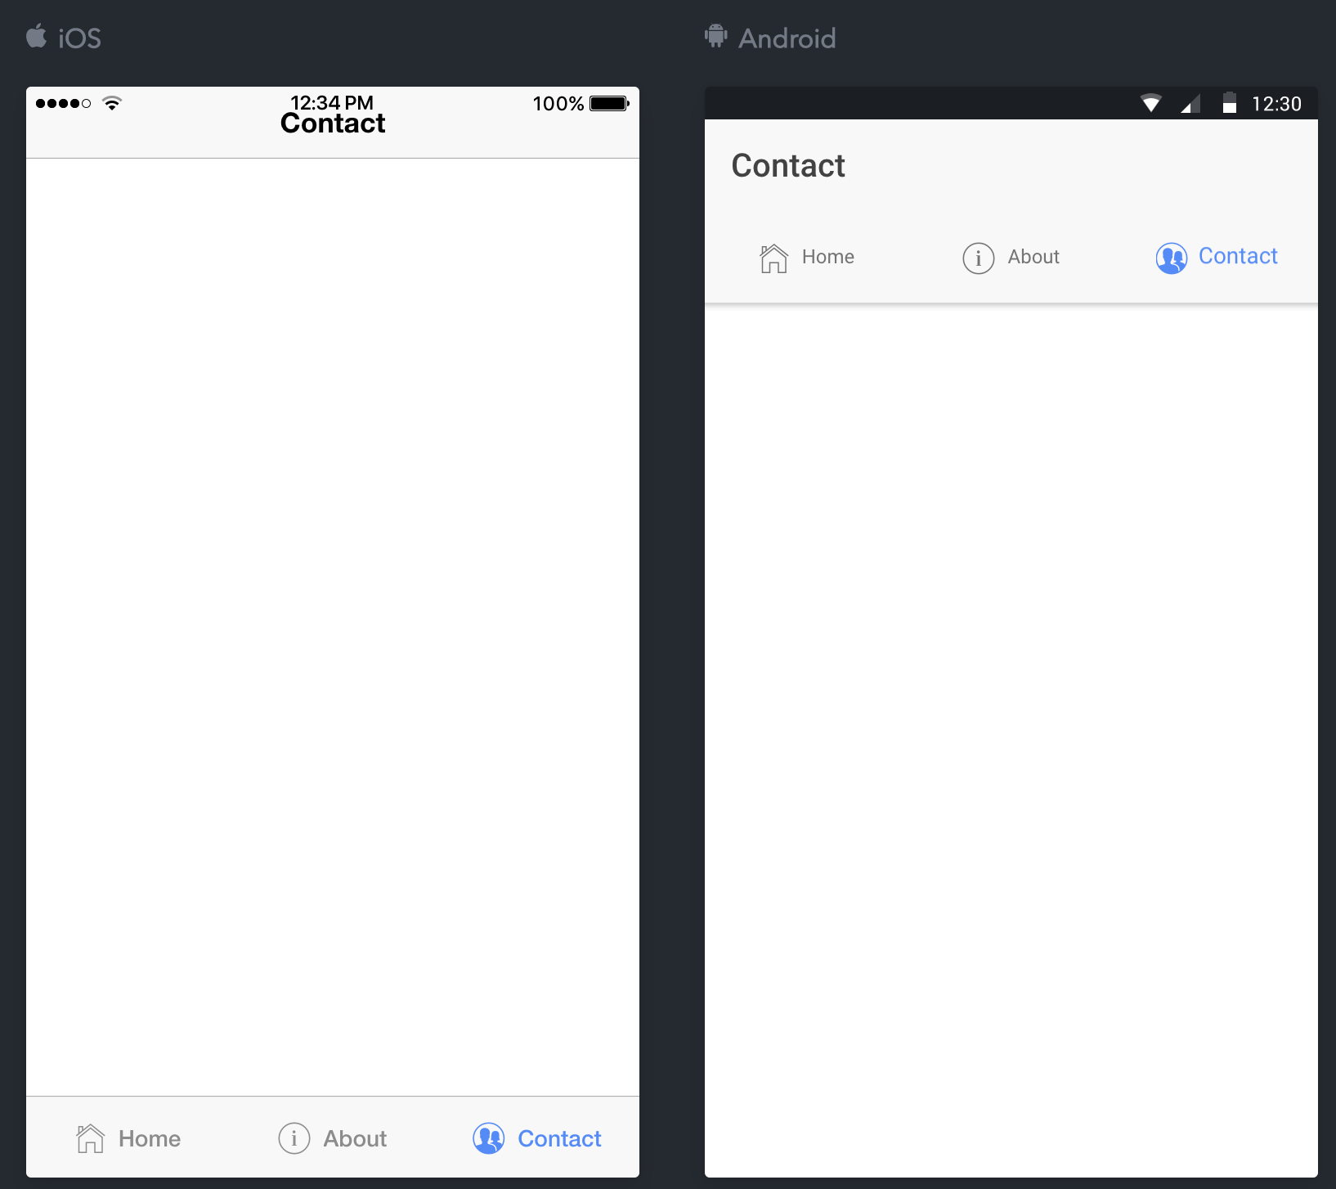
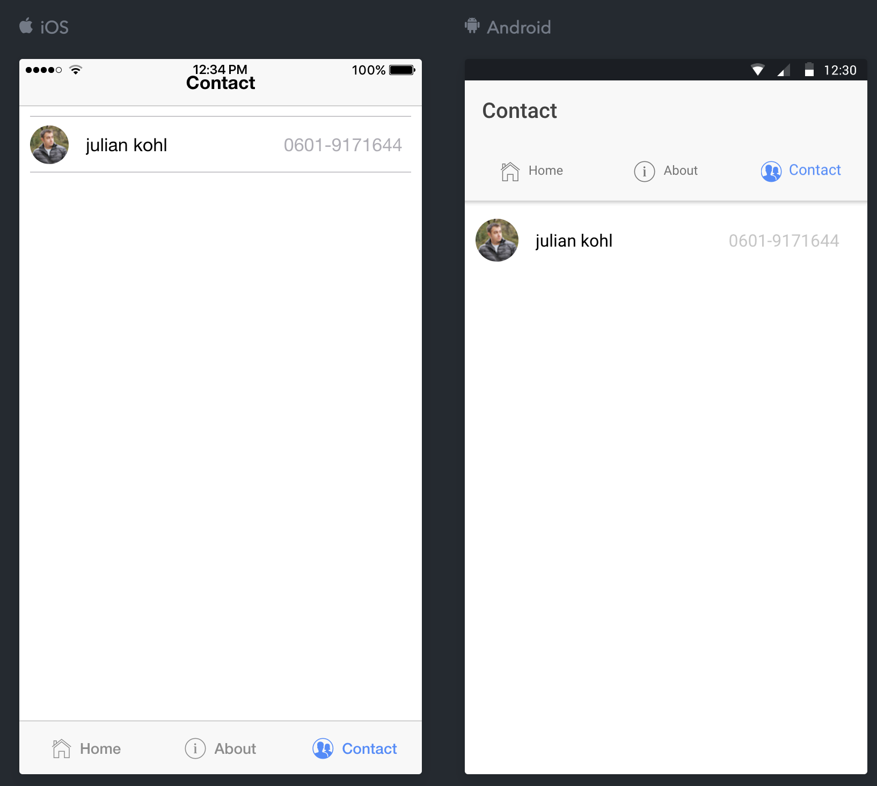
Introduction Menu Contact

Slide 4
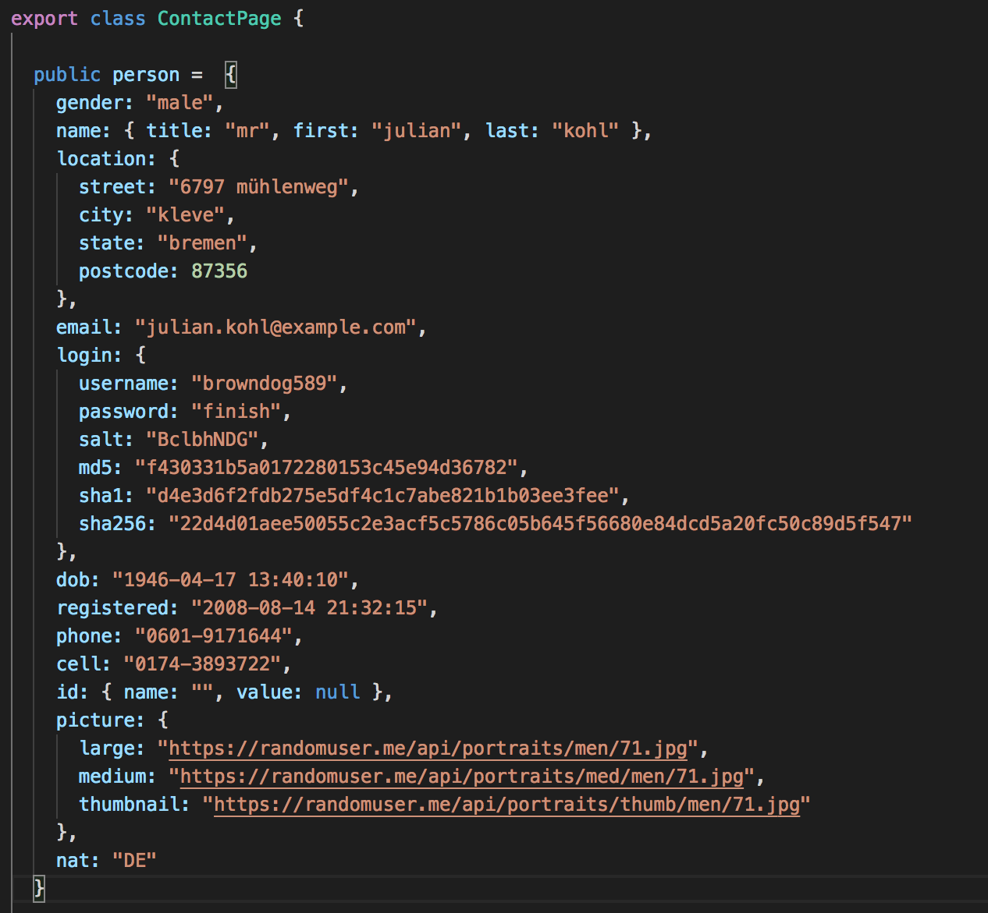
Introduction Menu Contact
contact.ts
Random user API (https://randomuser.me/documentation#intro)

Slide 5
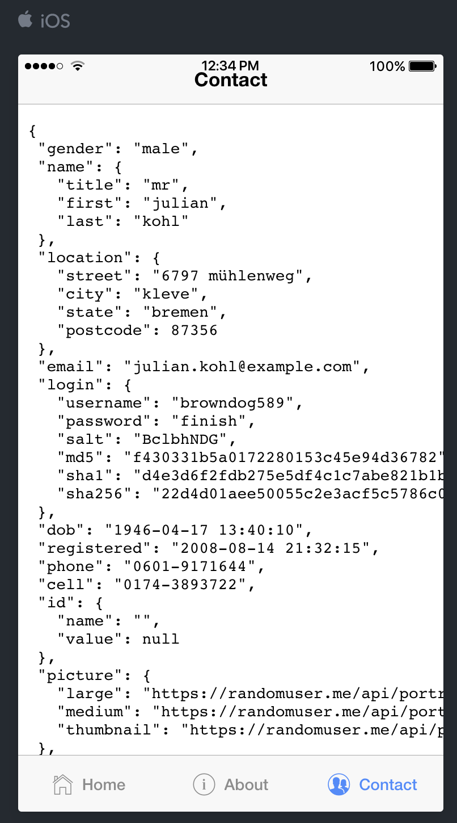
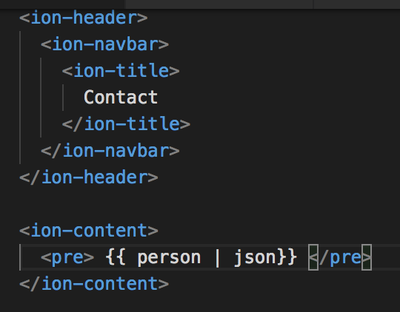
Introduction Menu Contact
contact.html

Slide 6
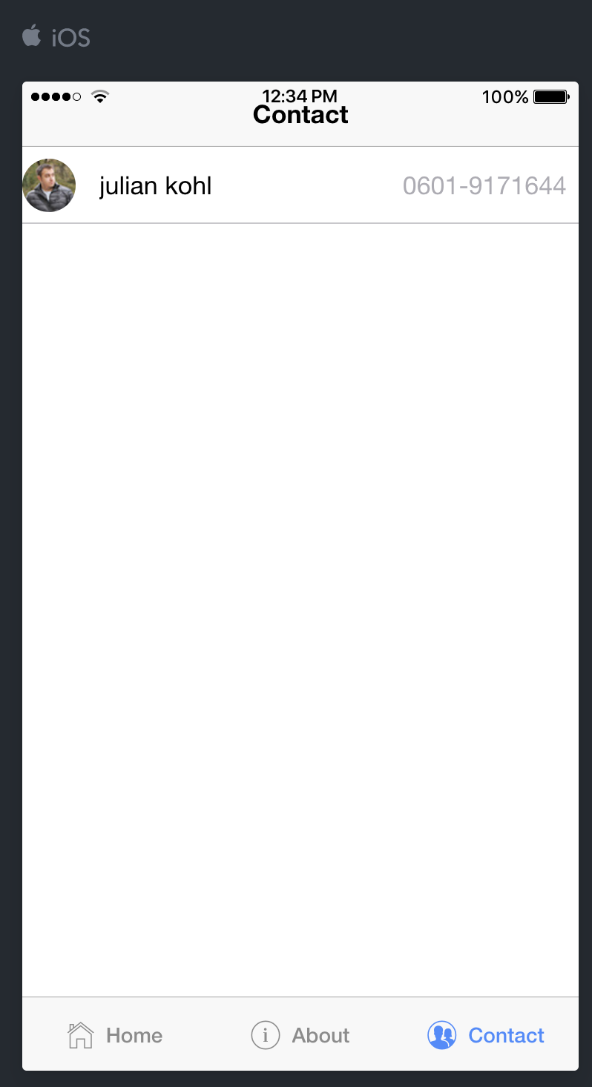
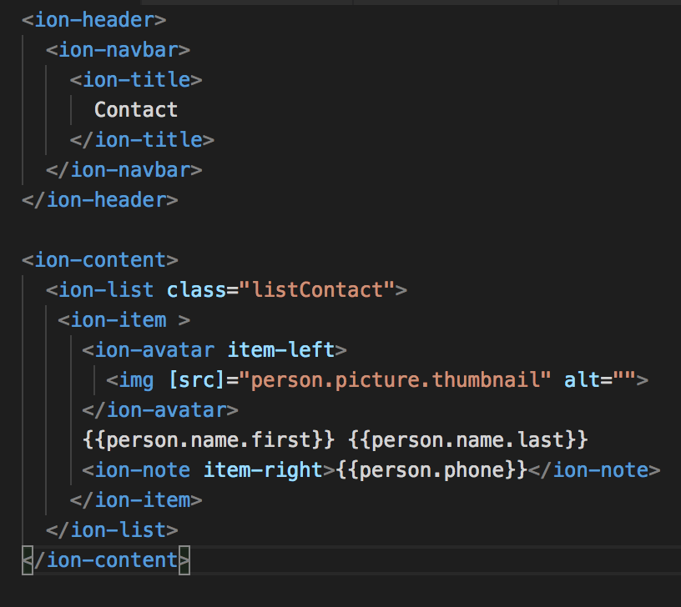
Introduction Menu Contact
contact.html

Slide 7
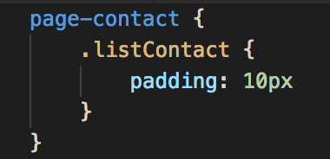
Introduction Menu Contact
contact.sass

Slide 8
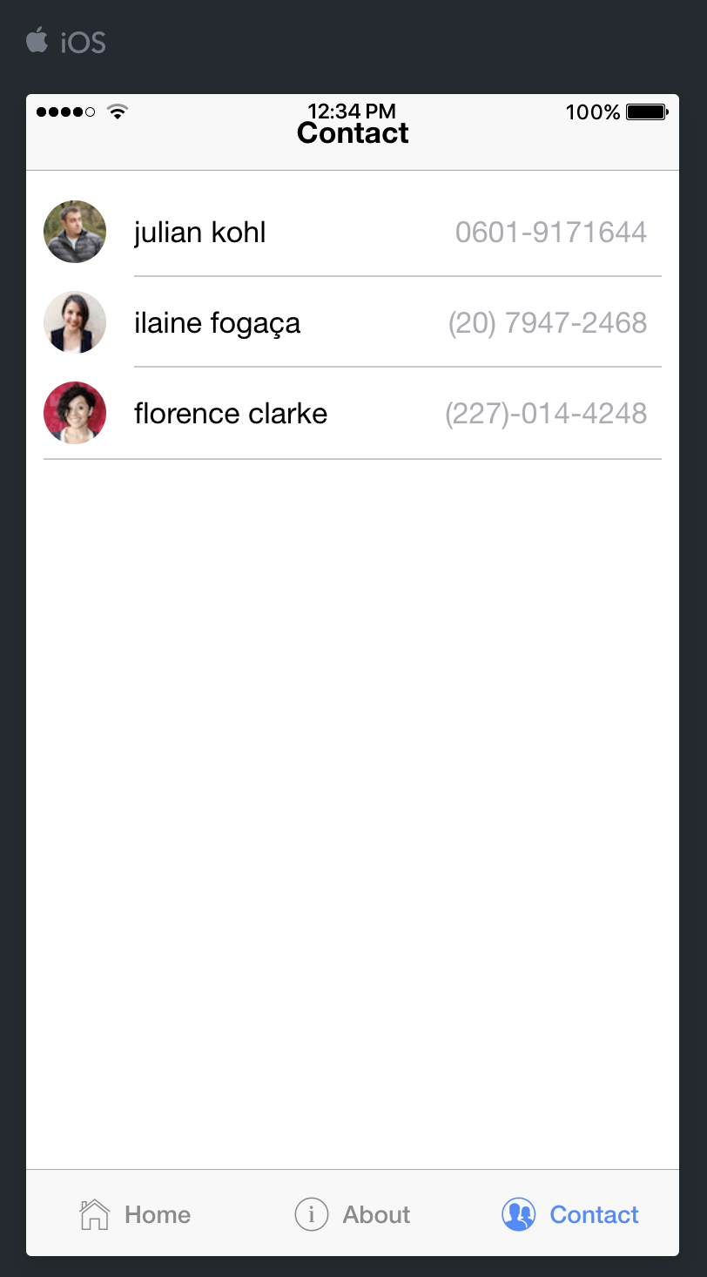
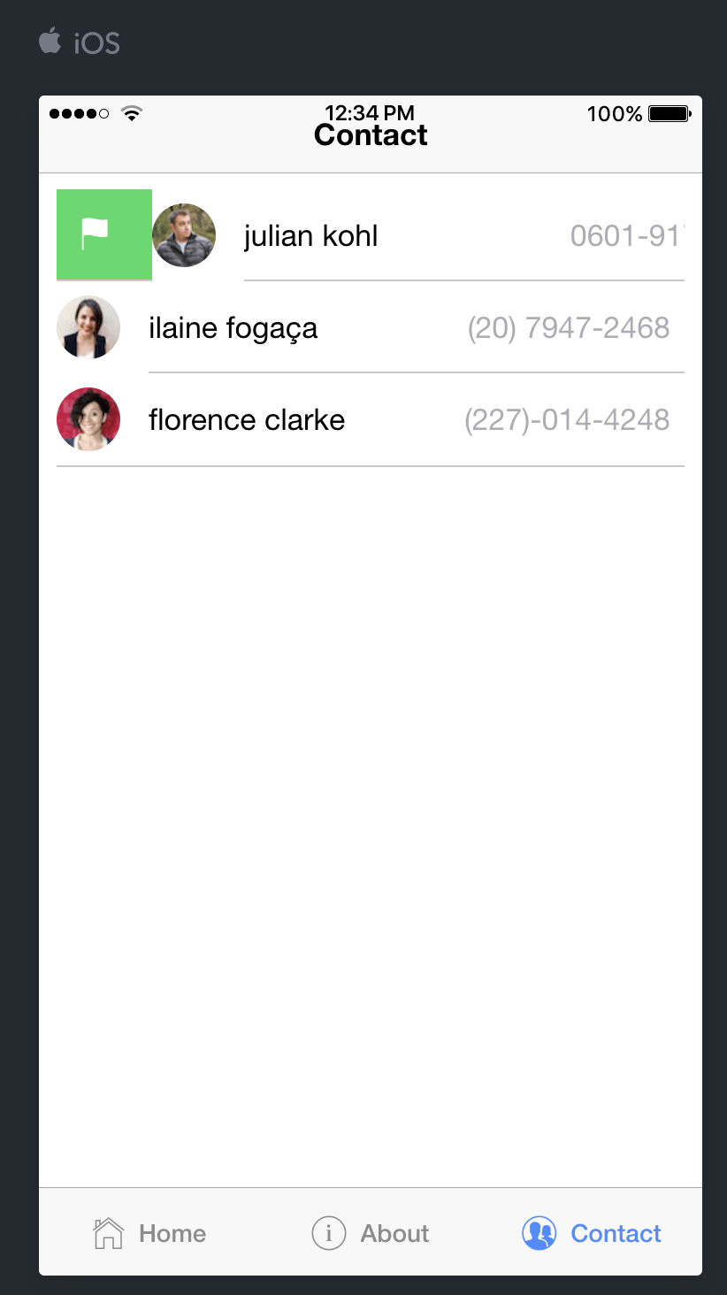
Introduction Menu List Contact

Slide 9
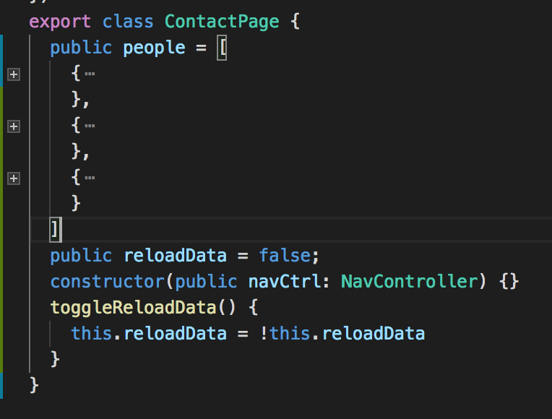
Introduction Menu List Contact
contact.ts

Slide 10
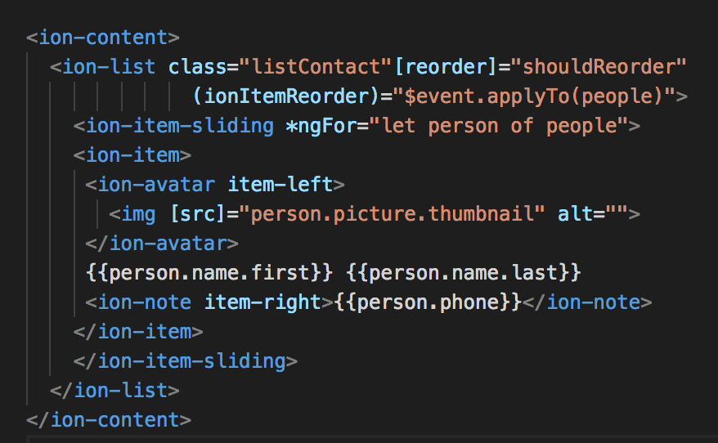
Introduction Menu List Contact
contact.html

Slide 11
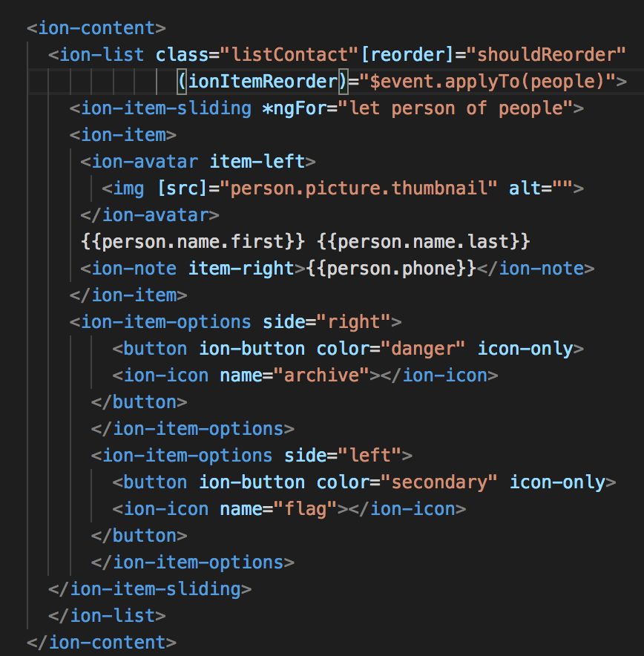
Introduction Menu List Contact
contact.html

Slide 12
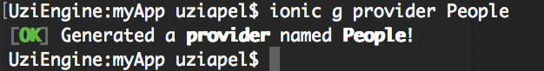
Make Provider People
Open terminal CMD
ionic g provider People

Slide 13
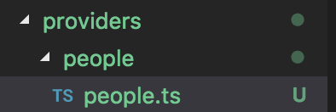
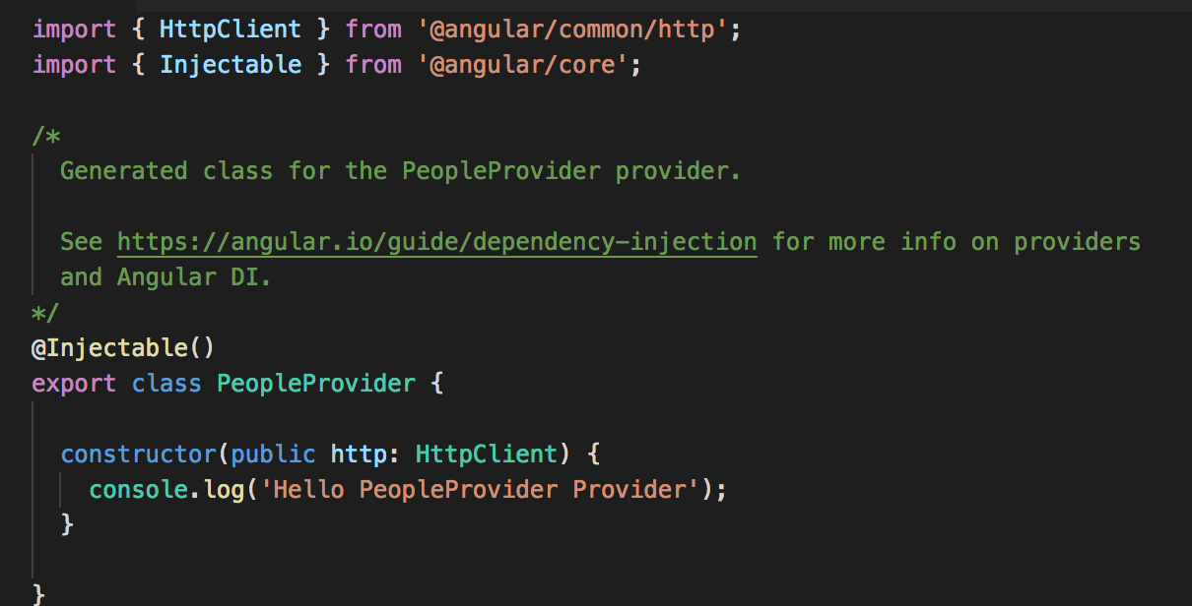
Make Provider People
Result :
Note: This project using Angular 5 (https://angular.io/guide/http)

Slide 14
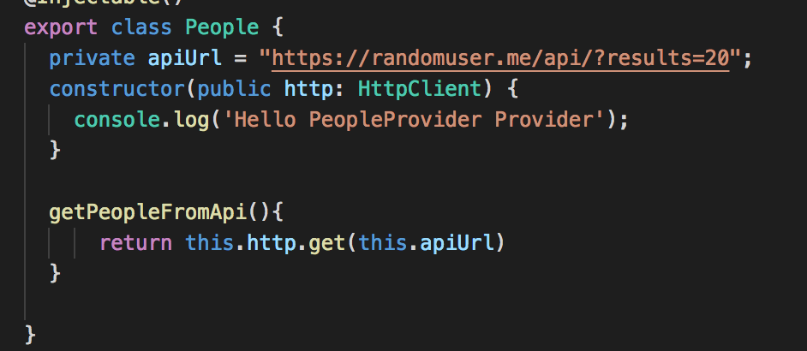
Synchronize Provider People
people.ts

Slide 15
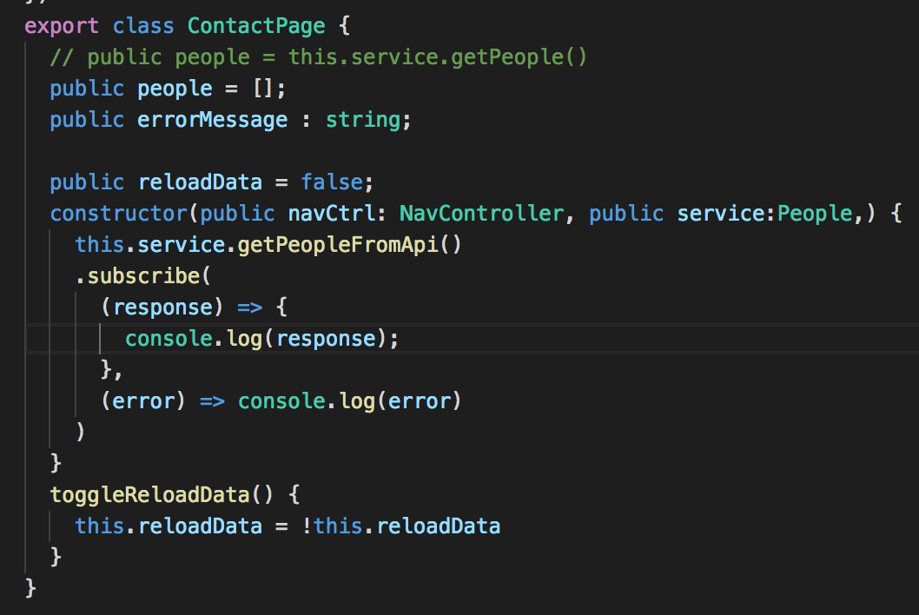
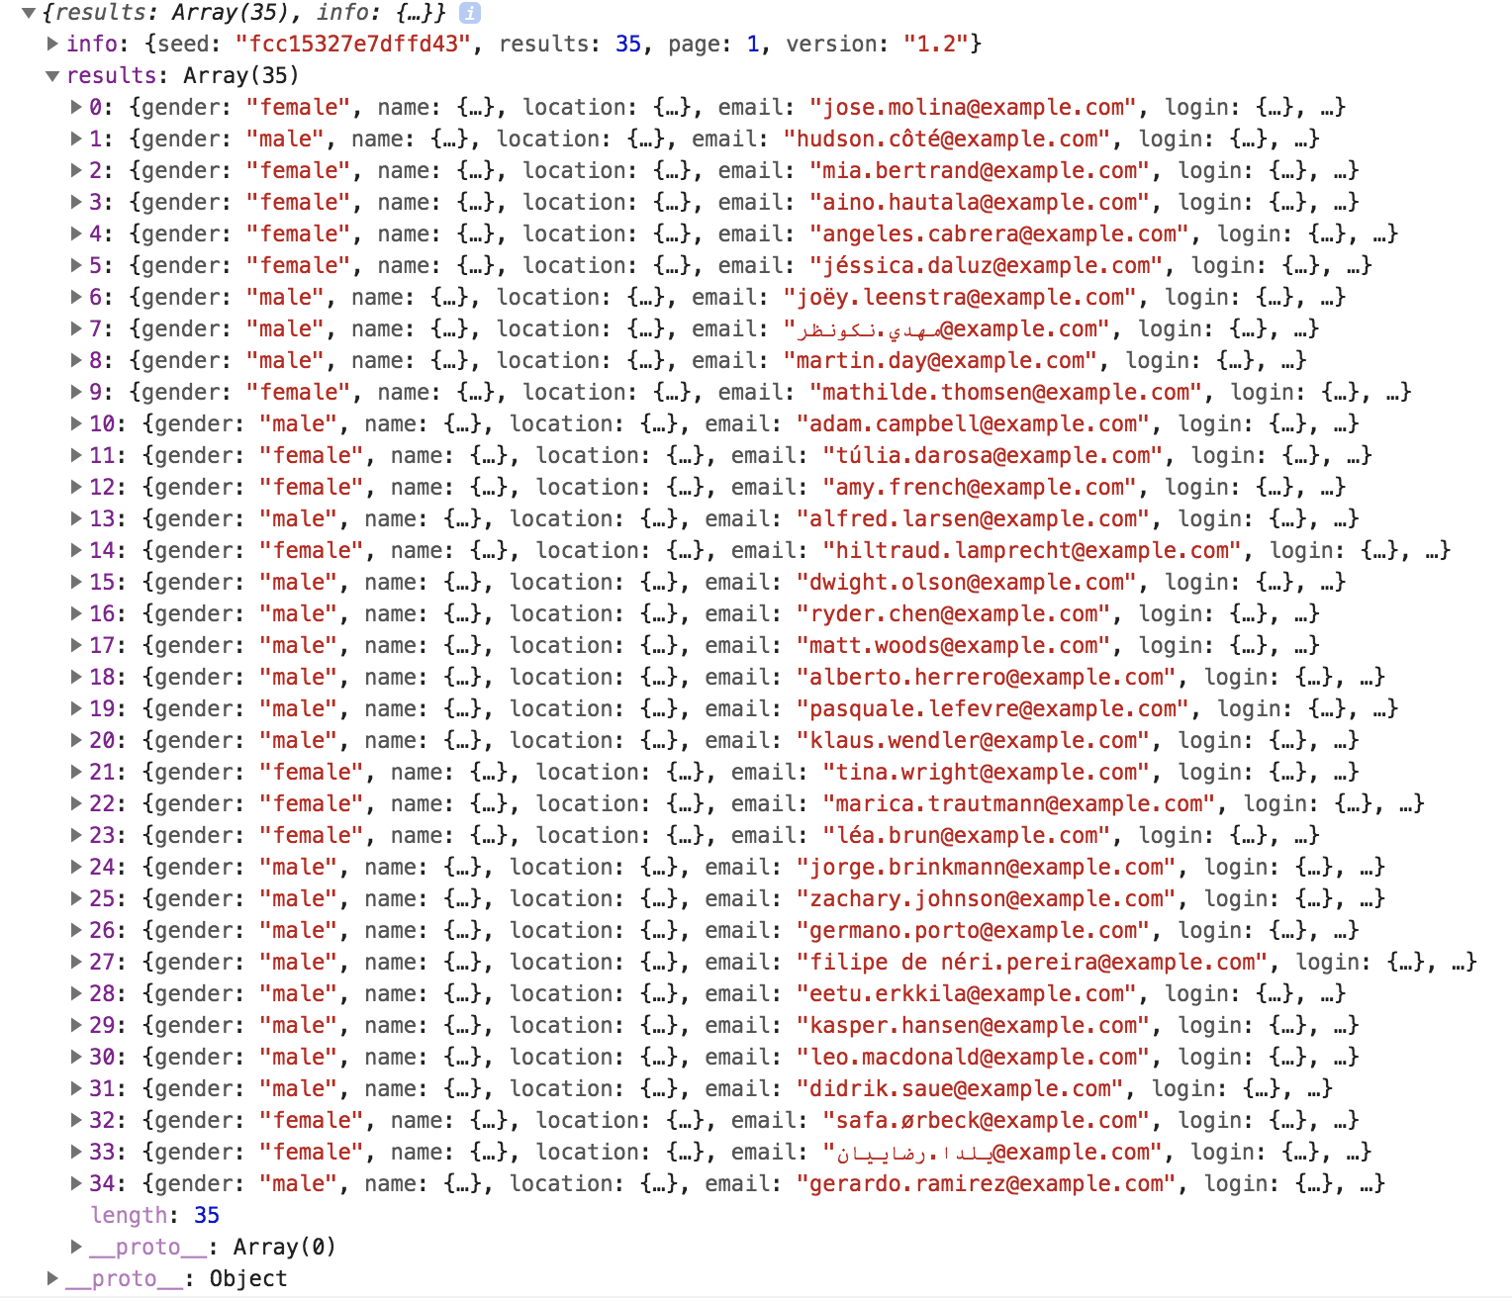
Synchronize Provider People
contact.ts
console :

Slide 16
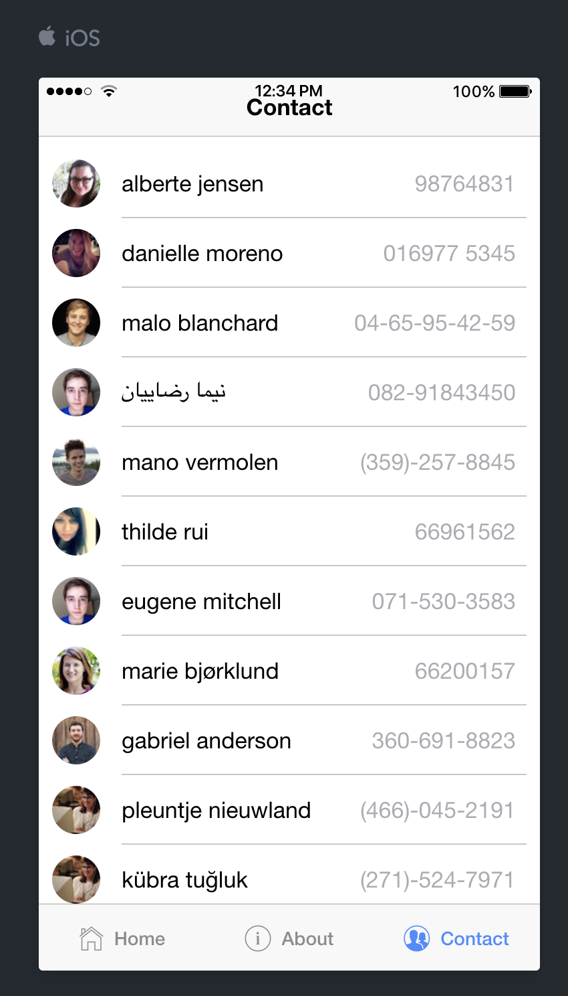
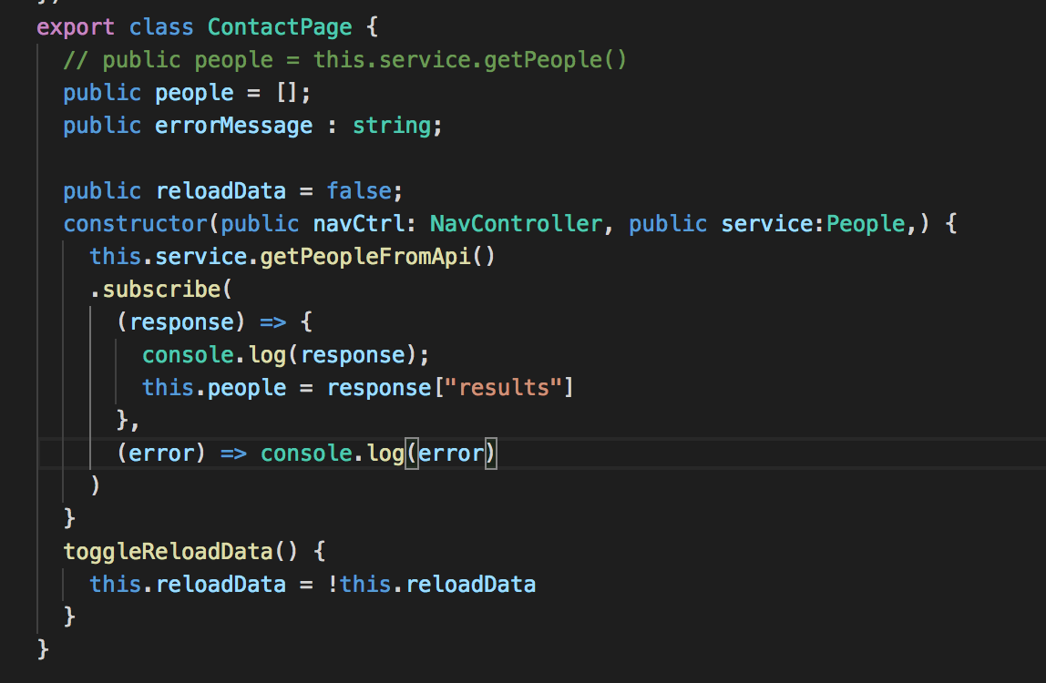
Synchronize Provider People
contact.ts
Notes:
// infinity scroll
// open profile
//

Slide 17
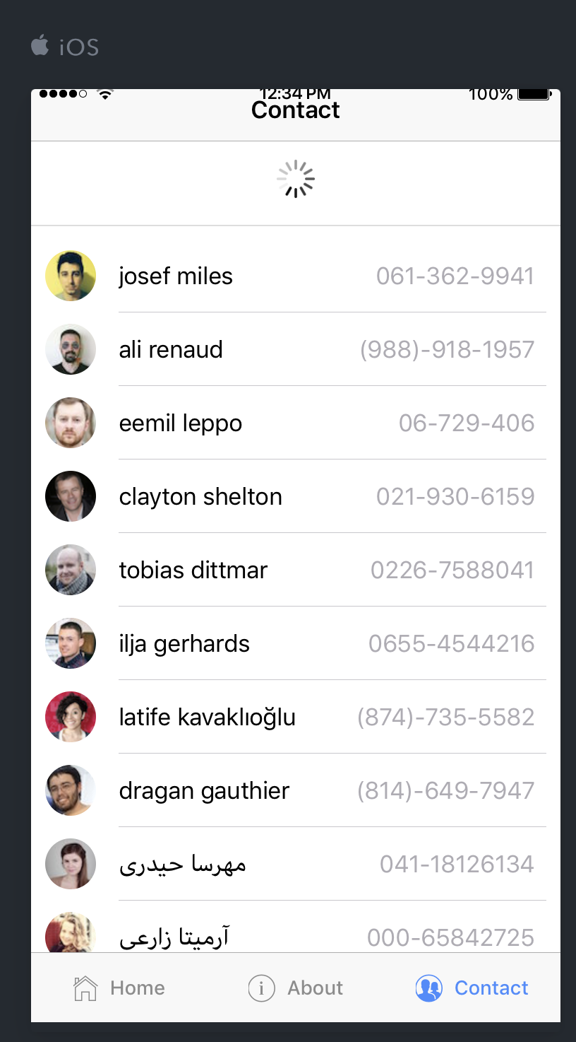
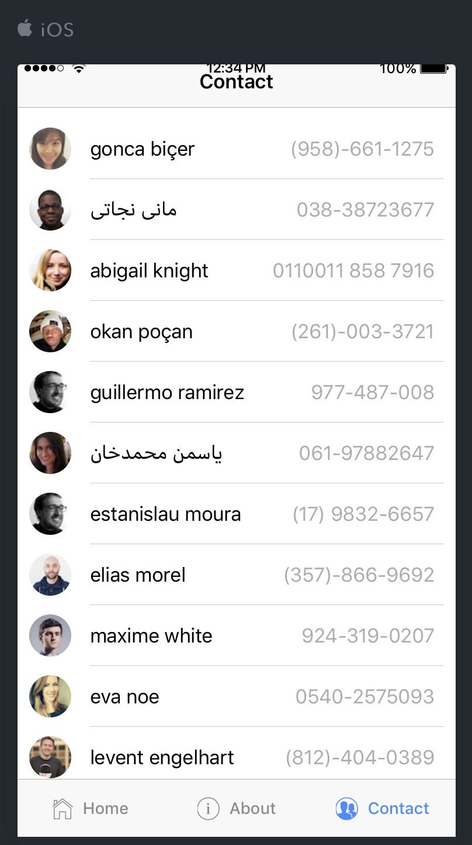
Refresh List

Slide 18
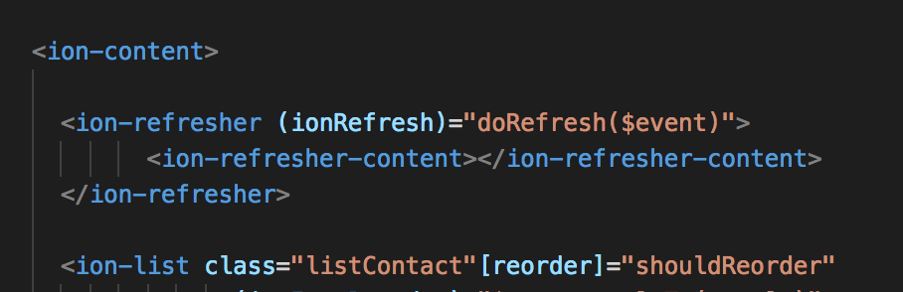
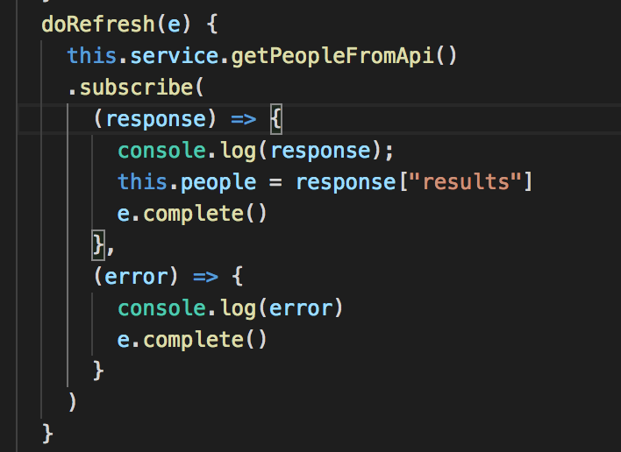
Refresh List
contact.html
contact.ts

Slide 19
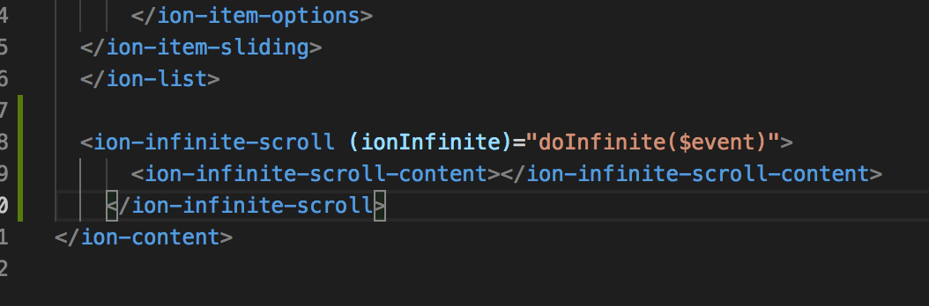
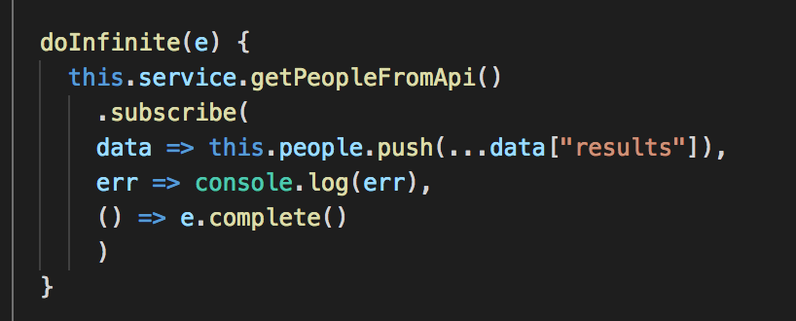
Infinite List
contact.html
contact.ts

Slide 20
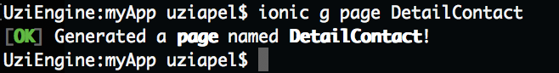
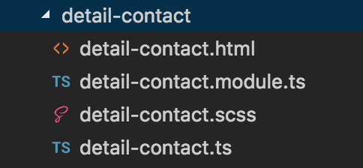
Navigate Between Mobile Screens
Create a new directory Detail Contact
Open Terminal CMD
In your myApp file :
Ionic g page DetailContact
Check on your project folder :

Slide 21
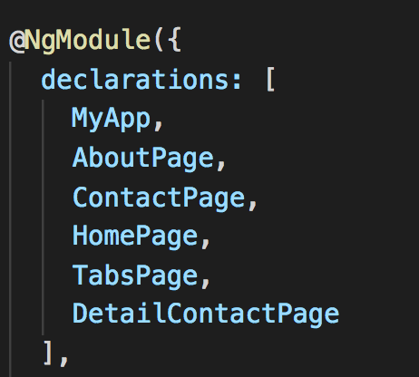
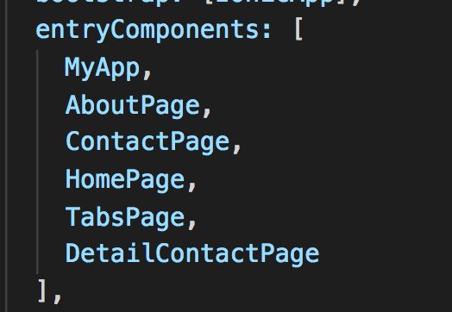
Navigate Between Mobile Screens
5. In App.module.ts add :

Slide 22
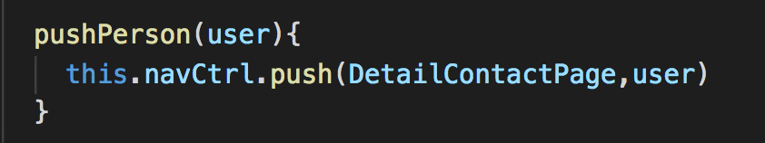
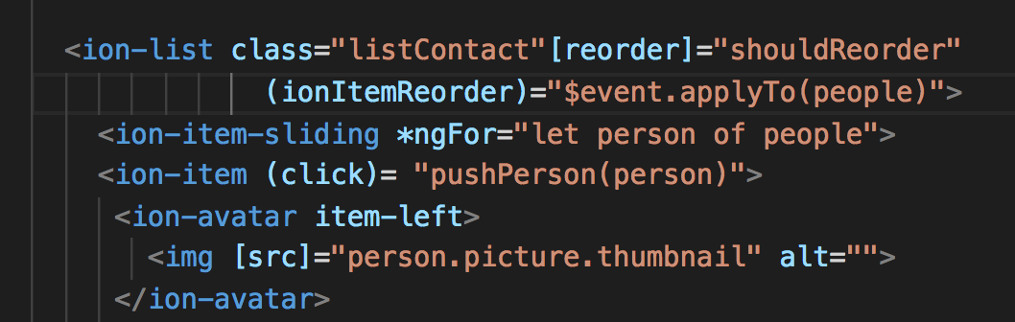
Navigate Between Mobile Screens
6. In contact.ts add :
7.In contact.html call pushPerson function with params person(from JSON structure):

Slide 23
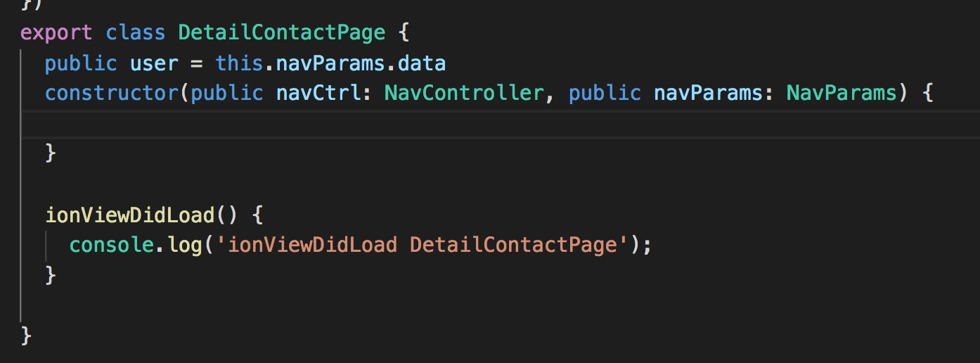
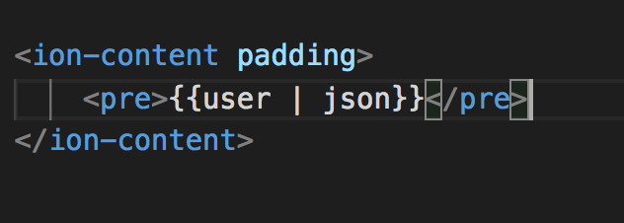
Navigate Between Mobile Screens
8. add variable user in DetailContactPage.ts
9. Show the JSON structure in DetailContactPage.ts

Slide 24
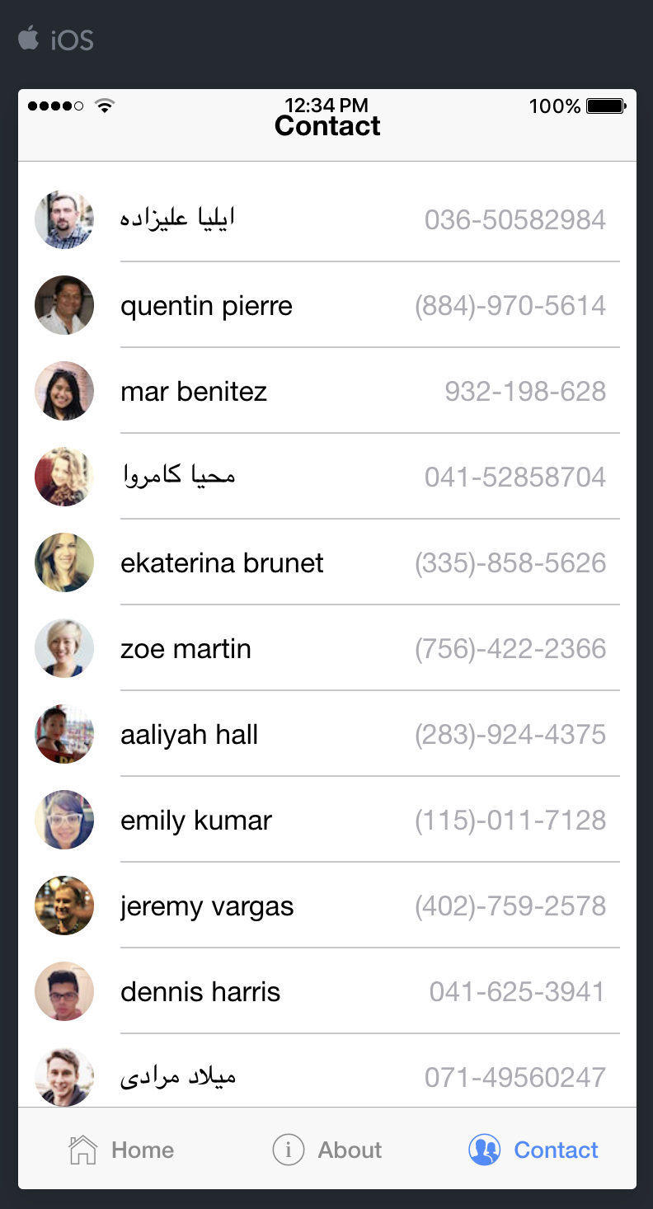
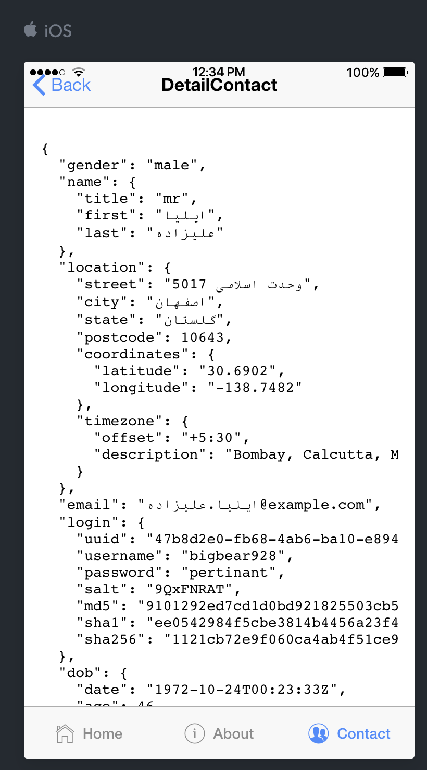
Navigate Between Mobile Screens

Slide 25
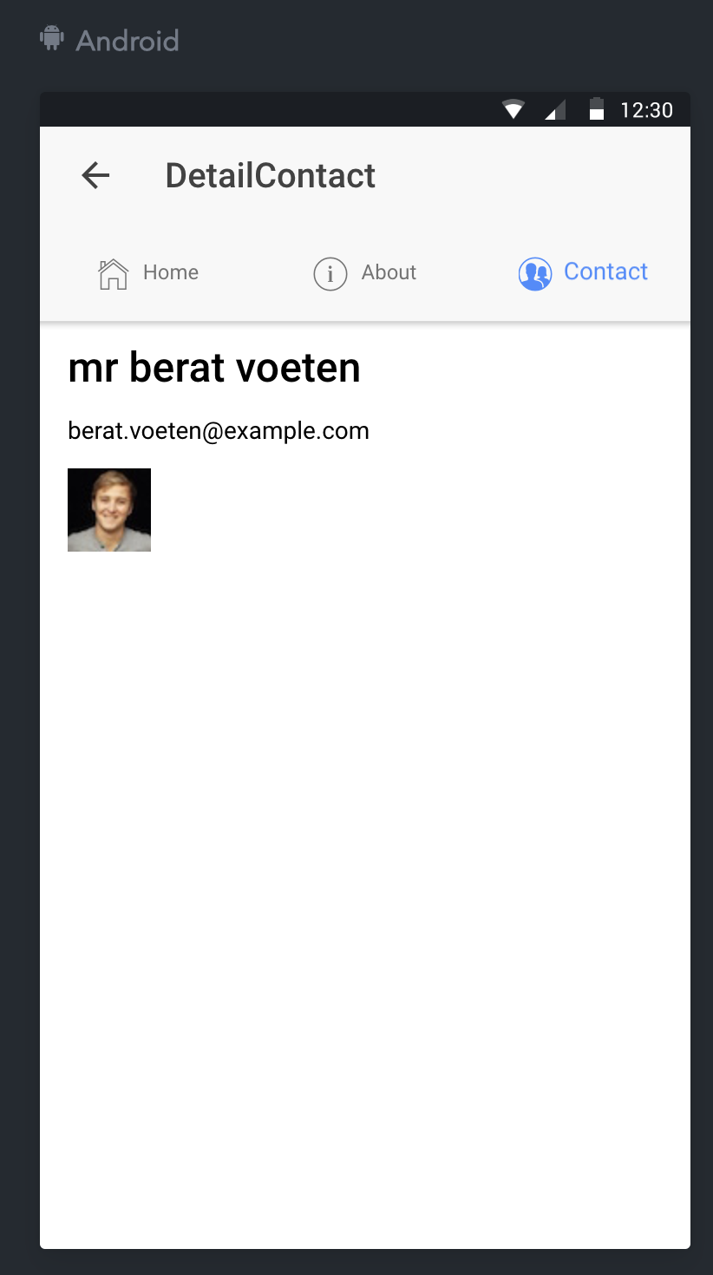
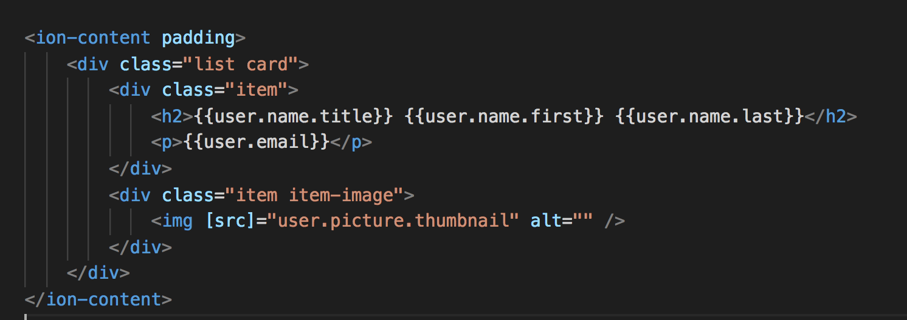
Navigate Between Mobile Screens
After finished, you could custom your own design for Detail Contact.

Slide 26
Open API reference
https://randomuser.me
https://openweathermap.org/
https://github.com/farizdotid/DAFTAR-API-LOKAL-INDONESIA

